Slide 1
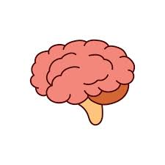
HMS – Harmful Brain Activity
Harmful Brain Activity Classification and Prediction
- Karan Kalra

Slide 2
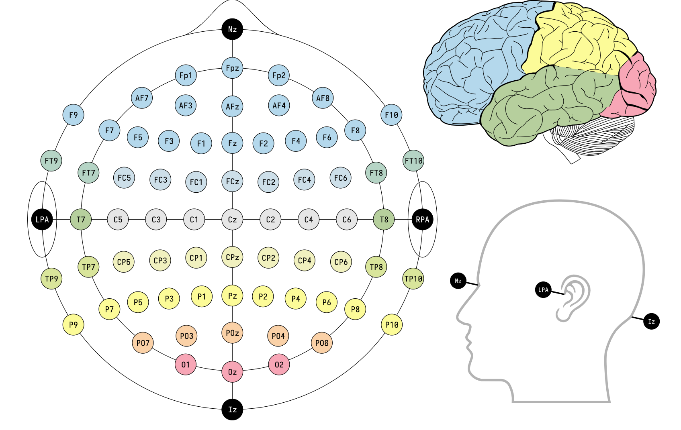
HMS – Harmful Brain Activity
Understanding the problem statement
The purpose of this capstone project is to identify and
categorize seizures and other forms of harmful brain activities by developing model trained on electroencephalography (EEG) signals recorded from critically ill hospital patients.
An electroencephalogram (EEG) is a test that detects electrical activity in the brain by attaching tiny metal discs (electrodes) to the scalp.

Slide 3
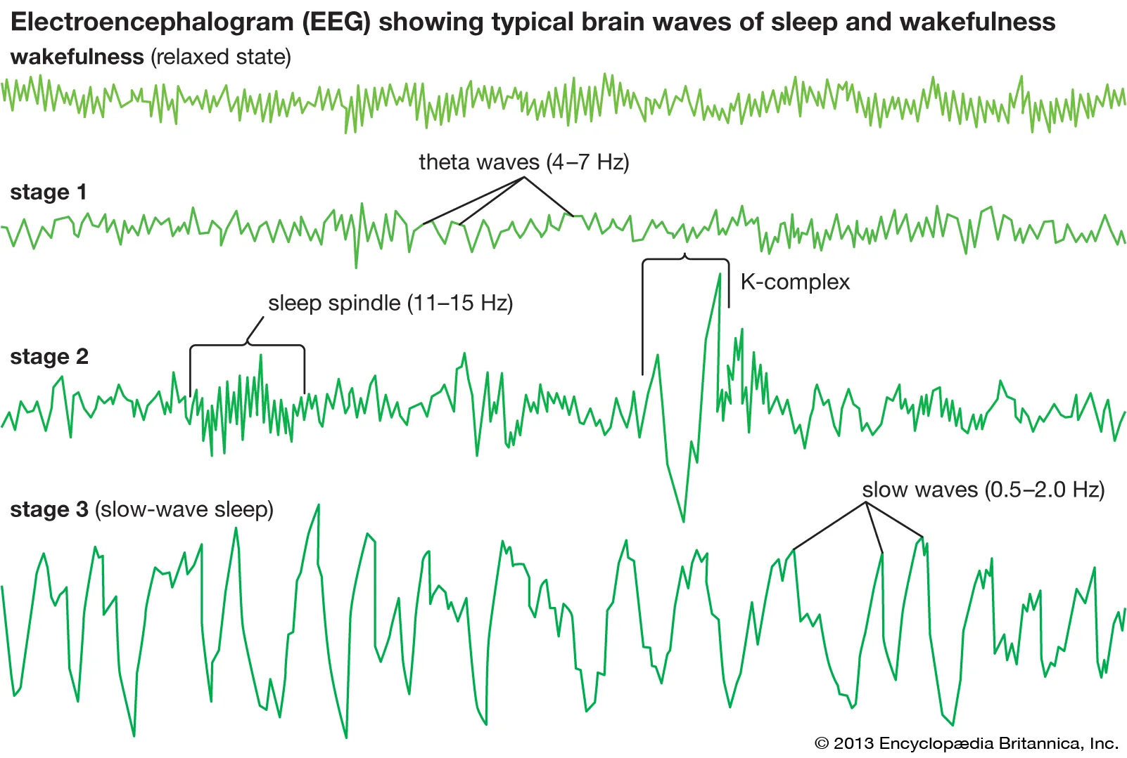
HMS – Harmful Brain Activity
Proposed Vision
My work will significantly increase electroencephalography pattern categorization accuracy, resulting in dramatic improvements for neurocritical care, epilepsy, sleep disorders, medication discovery, and in some cases brain tumor.

Slide 4
HMS – Harmful Brain Activity
Potential Impact
Currently, EEG monitoring is based primarily on manual analysis by specialist neurologists. While invaluable, this time-consuming operation is a significant bottleneck. Manual evaluation of EEG recordings is not only time-consuming, but also costly, prone to fatigue-related mistakes, and plagued by reliability concerns among diverse reviewers, even when those reviewers are specialists.
Advancements in this field may enable doctors and brain researchers to identify seizures or other forms of brain injury, allowing for faster and more precise treatment.

Slide 5
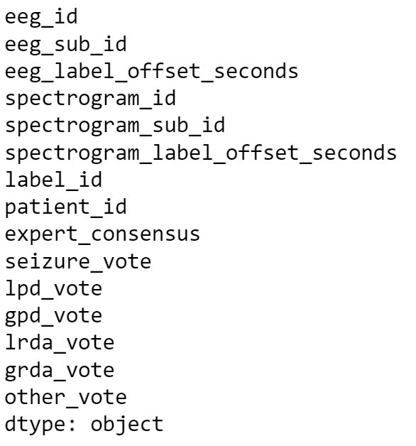
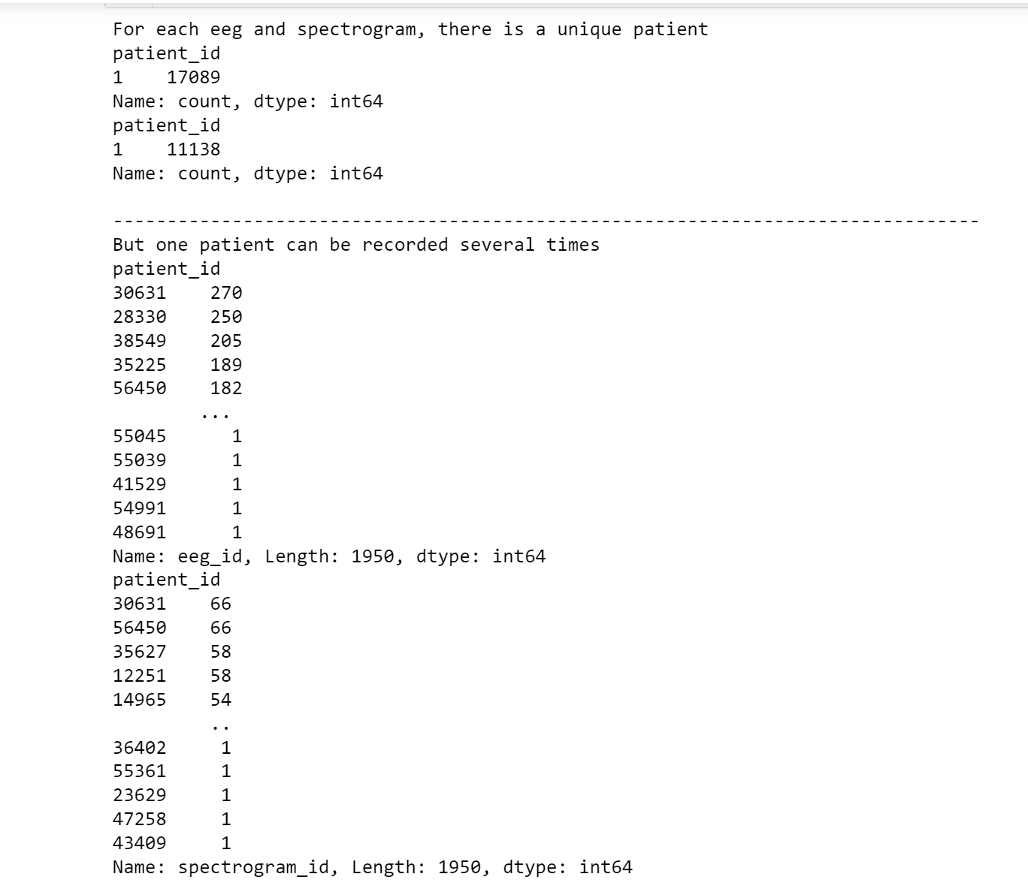
HMS – Harmful Brain Activity
Data Set and EDA
Unique identification

Slide 6
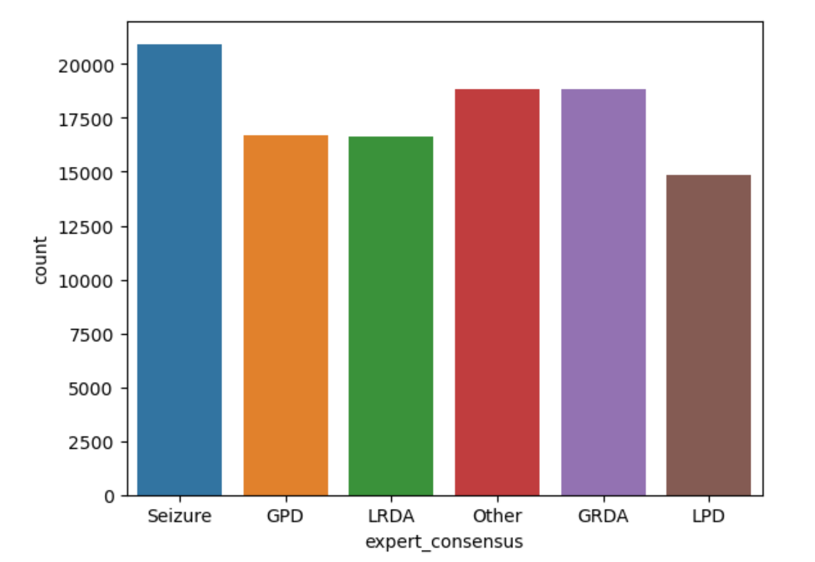
HMS – Harmful Brain Activity
Data Set and EDA
The dataset contains both the train and test data for EEG patterns. EEG data came from some overlapping samples.
The data consists of a lot of grouped samples which makes it tougher to understand and correlate eeg data and spectrogram data (Spectrograms represent a visual representation of a signal's signal strength over time)
Understanding the data with expert_consensus while dividing the different types of reading and seizures diverted into votes**
** still exploring

Slide 7
HMS – Harmful Brain Activity
Next Steps
The work in automating EEG analysis will help doctors and brain researchers detect seizures and other types of brain activity that can cause brain damage. The algorithms to be developed may also help researchers who are working to develop drugs to treat and prevent seizures.
Next step is to analyze and identify the patterns based off the eeg and spectrogram reading. Further identification can help one understand and plot the patterns and process information with it’s exact pattern name. Following are to be implemented,
Pattern recognition using Seizures, LPD, GPD, LRDA, GRDA
Logistic regression
Correlation
And more

